Slide 1
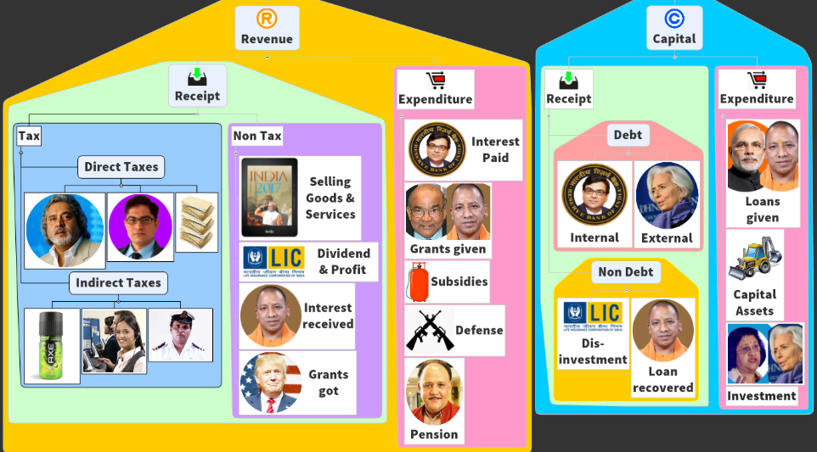
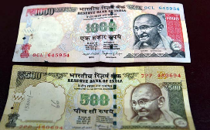
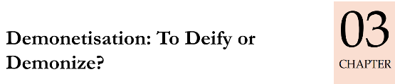
BES172: Budget ► Revenue ► Receipt ► Tax
Recent Acts & Schemes
Tax Admin: TDS, TCS….
Demonetization helped or not?
CGT: root of many problems
BEPS, AEoI
PoEM, GAAR [WEF1/4/17], AAR
Electoral-Bonds
Uniqueness
Then is it a failed experiment?
Security Features
Soil Rate?
How did 97% returned?
Short Term challenges Long term Benefits?
Goods & Services Tax
PPT Focus: Objective, factual. Not “analysis” for mains

Slide 2
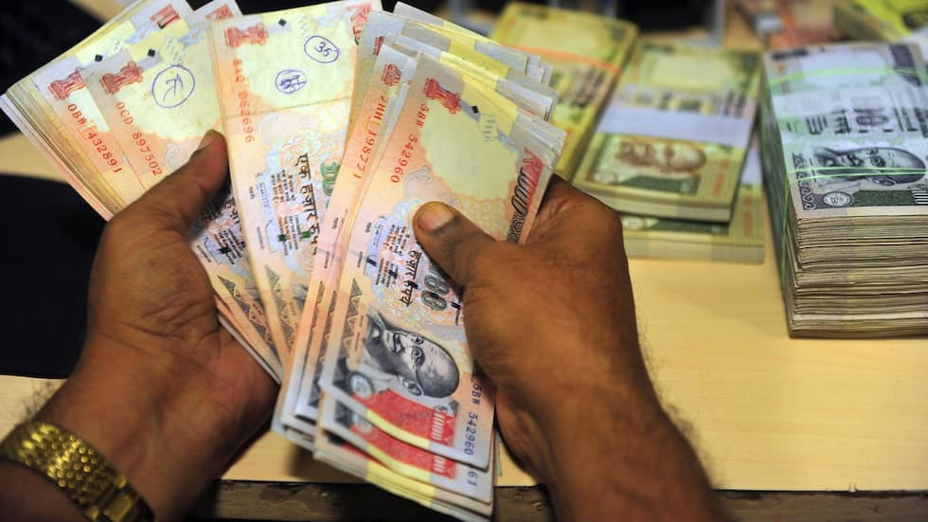
Demonetization in India already taught in first lecture
Did not have significant impact on cash!
1946
Declare 100|>
Demonetize 500|>
1978
Demonetize 1k,5k,10k
2016, Nov 8th
Rs. 500 and 1000 “Mahatma Gandhi series”
Except for specific usage till a date (petrol, hospital)
Elsewhere? HW
Self study Survey Ch3 last page

Slide 3

RBI Act 1934 Section 26 “legal tender”
Demonetization
Every bank note is legal tender
On RBI board’s recommendation, GoI can notify specific bank notes (SBN) are no longer legal tenders. (=“demonetized”)
8/Nov/2016: FinMin-> Dept of Economic Affairs gazette notification
Rs.500 and 1000 (86% of all notes)
Every bank and treasury ordered to deposit to RBI office
Aam junta ordered to deposit old notes in Banks by 30 Dec 2016.
Demonetization “wholesale withdrawal of currency notes from circulation.”

Slide 4
Specified Bank Notes (Cessation of Liabilities) Ordinance, 2016 30/12/16
Demonetization
Exchanging Notes @RBI:
old Rs 500 and Rs 1,000 notes are no longer RBI's liability from 31/12/16.
But union can give grace period to deposit these notes to RBI. (e.g. NRI) with proof.
RBI to credit notes in KYC bank account.
False claims punishment: Rs.50k OR 5x the claim value whichever higher.
Ceiling on holding old notes
Max. 10 notes for individual
Max. 25 notes for research / numismatics
Others allowed by court / RBI.
Else punishment: Rs 10,000, OR 5x the value of notes whichever higher.
2017: Budget session - Specified Bank Notes ( Cessation of Liabilities ) Bill, 2017 to replace this ordinance

Slide 5
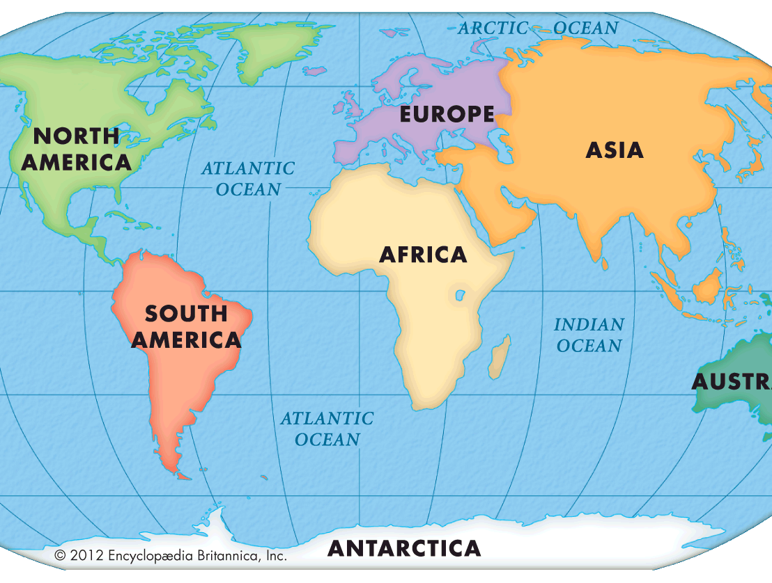
Sweden (2013)
But Old notes allowed till 2017
EU (2016)
500 euro stopped by 2018
War
Hyperinflation
political upheavals
Pakistan (2015)
Old notes to be accepted till 2021!
Corruption
Counterfeiting
Terror finance
Black money
unprecedented in secrecy and suddenness
8 Nov-30 Dec.

Slide 6
2015-16: Helicopter Money
ECB: buys bonds and “Destroys” them
Rain of “New money”, High “Liquidity”
Quantitative Easing [2008-15]
Fed Reserve buys toxic assets, releases new money
Demonetization
“Destroys” SBN
“Reverse of helicopter drop”
“helicopter hoover”

Slide 7
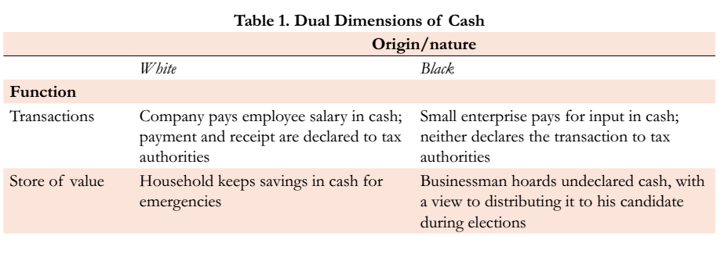
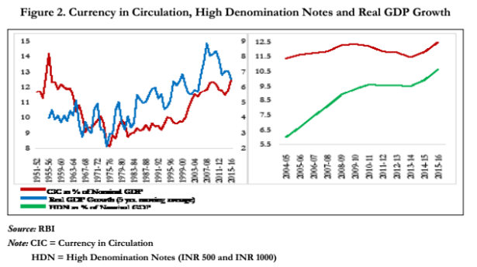
Functions of money: first lecture
Medium
As GDP ▲ Currency use increase, for transaction,
Incl. high denomination notes since lifestyle ▲ (Pizza, movie)

Slide 8
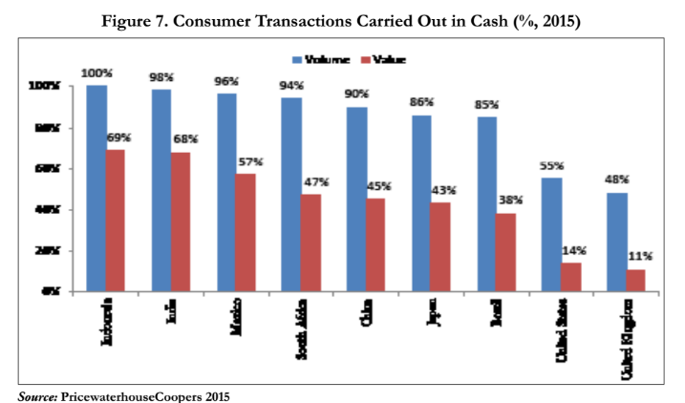
Numbers higher than China, Japan, US
Cash reliance?
12.04% Cash to GDP ratio! one of the highest in the world
Currency: printing, transport etc. 1.7% of GDP (can reduce to 1.3% by digital payment promotion)
Out of total transactions: 68% by value and
98% by volume done via CASH

Slide 9

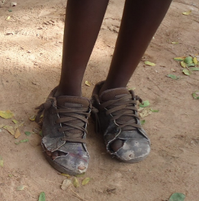
Was Black money stored in SBN? Let’s find via “Soil rate”
Rs.10,20,50,100
Lower denomination: 33% soil rate
“soil rates,” that is the rate at which notes are considered to be too damaged to use and have been returned to the central bank.

Slide 10
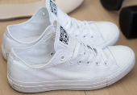
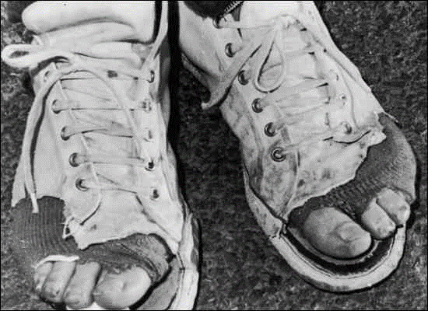
Was Black money stored in SBN? Let’s find via “Soil rate”
Rs. 10 to 100 | 33%
Rs. 500 | 22%
Rs. 1000 | 11%
Transaction Lower frequency [10-20 milk]
Storing black money?
Compared to US $20,50,100 soil rates
~3 lakh cr (2% of GDP) is stored black money in Rs. 500 and Rs.1000 Notes!

Slide 11
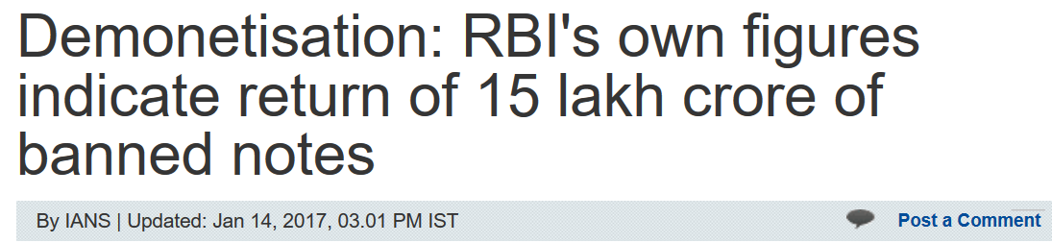
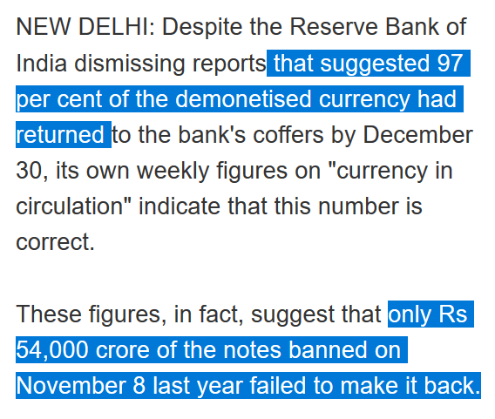
News after two months!!
SBN: total 15 lakh cr.
3.6% didn’t return
Rs.54,000 cr black money destroyed
Soil rate: If 3 lakh crore black money then ~20% shouldn’t return!
Notes:
http://economictimes.indiatimes.com/news/economy/finance/recall-could-cost-a-massive-rs-1-28-lakh-crore-says-cmie/articleshow/55608552.cms

Slide 12
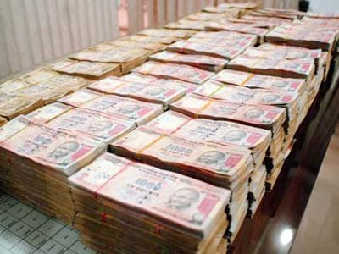
9 Methods: HOW Black money in SBN came back in system?
Money mules JDY & others <Link>
Back-dated FD in Cooperative [CBS, LINK];
Donations trust, temples, pol. Parties
Backdated gold, assets purchase, SELL
“Loans” to poor & Advance salaries
Agri. Income tax 0%: backdated Mandi-sales
Agents, bankers Exchanging notes without KYC
Misc. creative ways: Book-cancel tickets
Bankers: old notes-> RTGS to shell firms

Slide 13
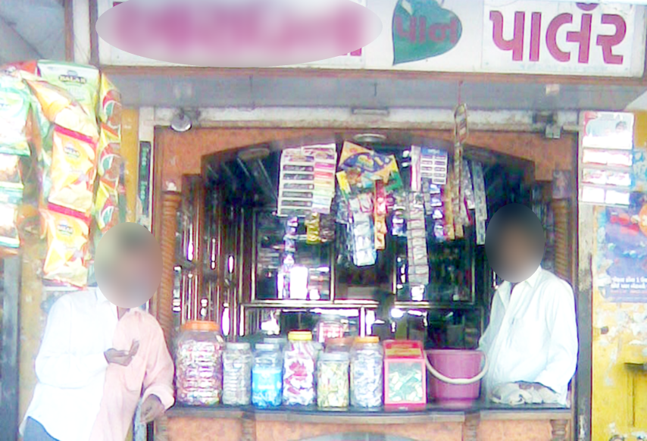
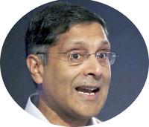
Even if 97% SBN “Returned”: Demonetization is tax on black money
Agent, bank official __% commission
Don’t submit: 100%
PM Garib Kalyan Yojana 50%, freeze
Back-dated invoice: __VAT%
JDY __%
Poor man commission
Shell companies: 18.5% MAT. Benami Act, SEBI penny stock
Labour: ATM withdrawal commission %
Advance salary: Interest lost!?
पान के गल्ले पे बैठने वालो…. तुम लोग गलत हो!!
Demonetization is NOT A FAILED EXPERIMENT

Slide 14
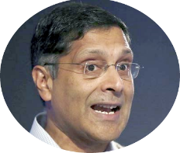
Demonetization = redistribution of WEALTH
Rich sitting in ivory towers
Poor standing in ATM-queues
Private sector
Public sector (Govt)
More service, excise, VAT, GST registration
Post-Demonetization, IT launched Operation Clean Money:
Phase-I: 18 lakh people asked to explain their deposit OR pay penalty.
Phase-II: 60k people who made high value transactions post Demonetization.

Slide 15


Demonetization: short term challenge, long term benefit
impact
Short
Long
Banking
Lending interest ▼
Wealth
Pvt wealth: Real estate price ▼
Deposit interest ▼
Public wealth ▲
Real Estate
Sales ▼
Prices ▼
affordable houses = migrant mobility, rent ▼

Slide 16
Demonetization: short term challenge, long term benefit
impact
Short
Long
Broader economy
Job loss, farm income, films
Stability, “Formal jobs”
GDP
Slowdown
Improvement
Tax collection
Workload “notice”, Analytics
Compliance
SELF Study: Eco survey ch3, table 2 “impact of dem” Download LINK

Slide 17
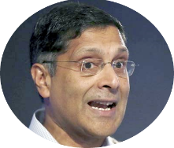
Survey Ch3. Demonetization
Jobloss,
social disruption,
deaths in ATM lines.
Secret agenda of solving NPA problem, even PAC reprimanded Urjit Patel!
Survey is not "public forum" for discussion and criticism. सर्वे “गल्ला-पुराण” नही है.
Short term challenges, long term benefits.
Let the data come.
Q3-2016 growth rate 7% how? <more in BES17”4”: GDP>

Slide 18
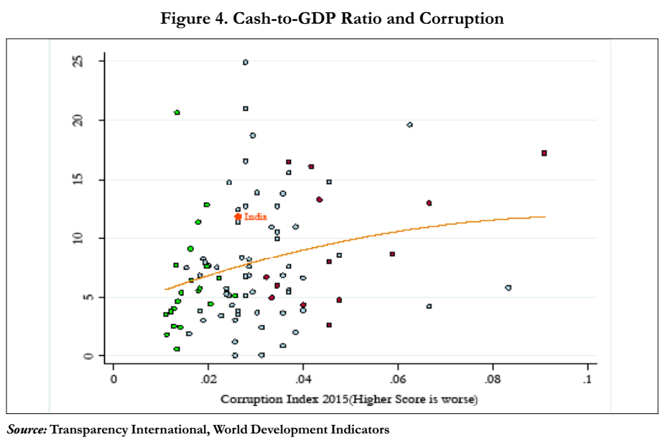
Survey Ch.3 Demonetization : misc. observations
India is “Above the line”= Corruption less yet SBN high
Either corruption is under reported
Heavy use of cash for transaction (soil rate)!? | “STORE”. (black)
International
SBN as per corruption

Slide 19
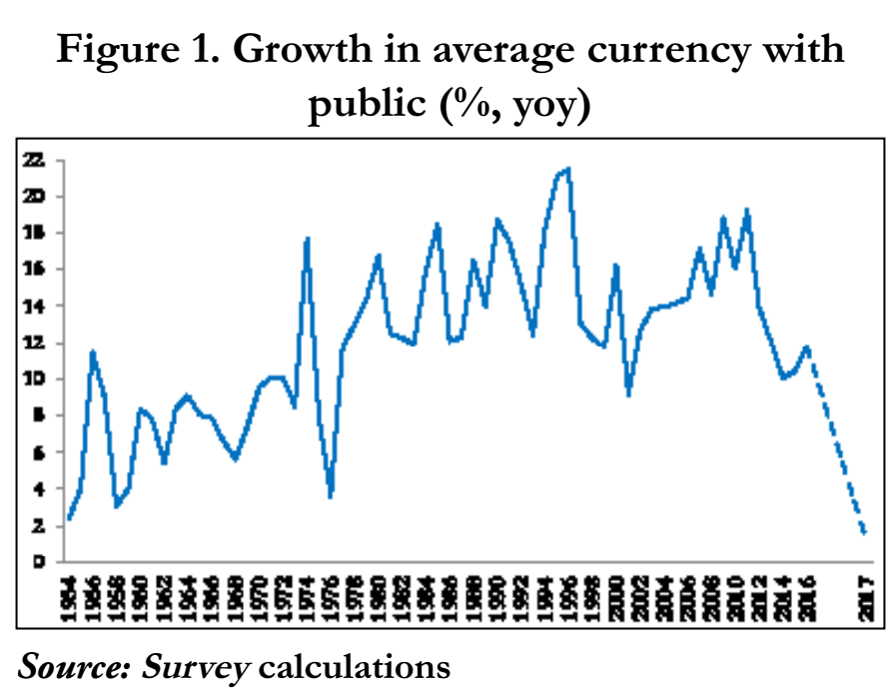
Currency with public : GDP
Dem = decrease cash:GDP By 2%
During inflation, declines, as more invested in gold, real estate.
During inflation, declines, as more invested in gold, real estate.

Slide 20
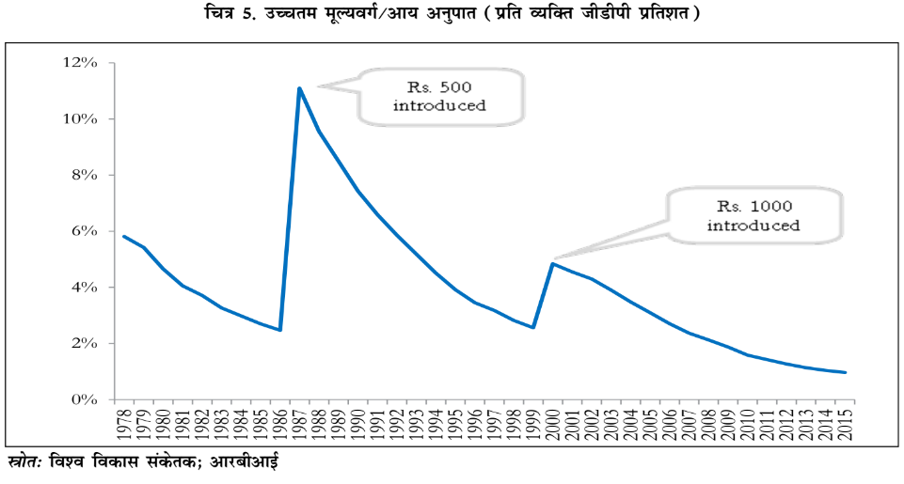
High value notes as percentage of GDP
Timepass page-fillers in survey

Slide 21
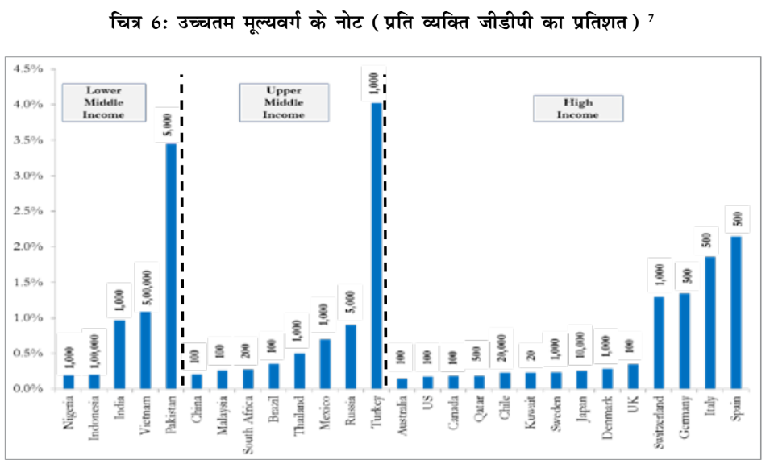
High income countries don’t have high denomination notes!! but they’ve lower inflation and price levels!
Timepass page-fillers in survey

Slide 22
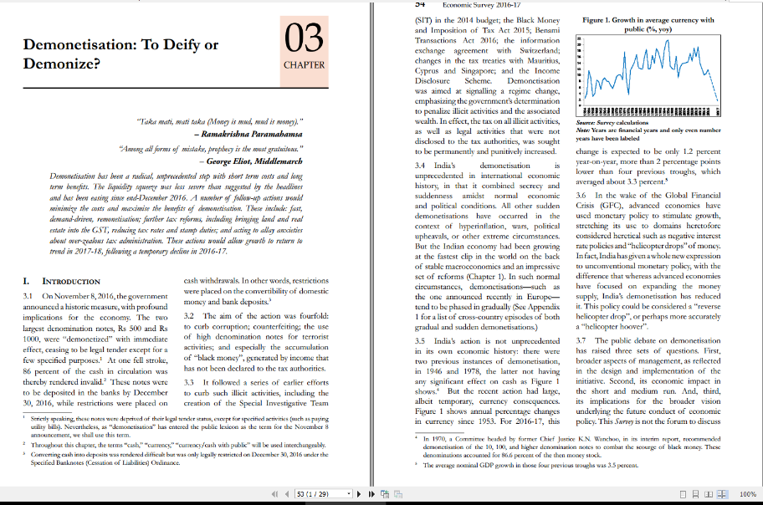
29 pages bol bachchan:
introduction, conclusion
Table 2 (impact) and table 3 (other nations)
“interoperability” digital payment already taught
Why did not GDP growth rate fall drastically, in Q3 <GDP lecture under BES17”4”>

Slide 23
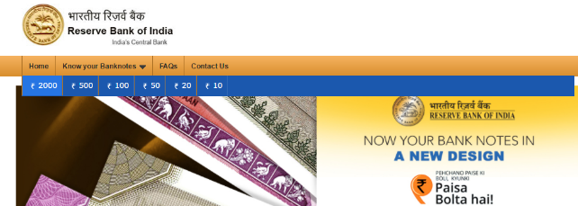

Security features: paisaboltahai.rbi.org.in
Corruption
Counterfeiting
Terror finance
Black money

Slide 24
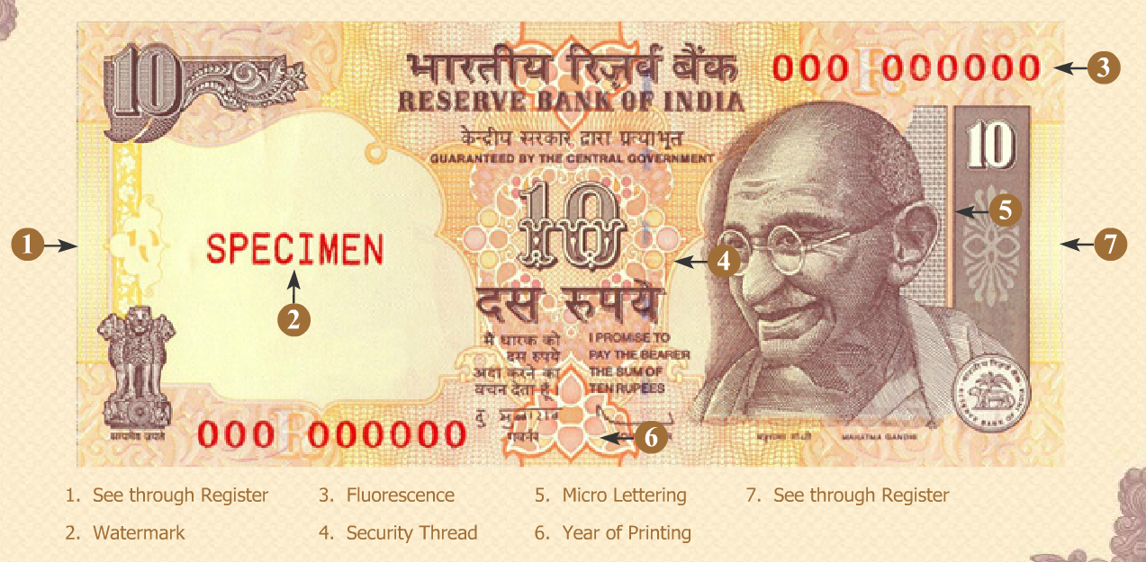
Coin, medal, currency: Front side “obverse” side
VH=
Nothing
Antonym of “Obverse” is [SSC CGL, IBPS-CWE]
Converse
Diverse
Inverse
Reverse

Slide 25
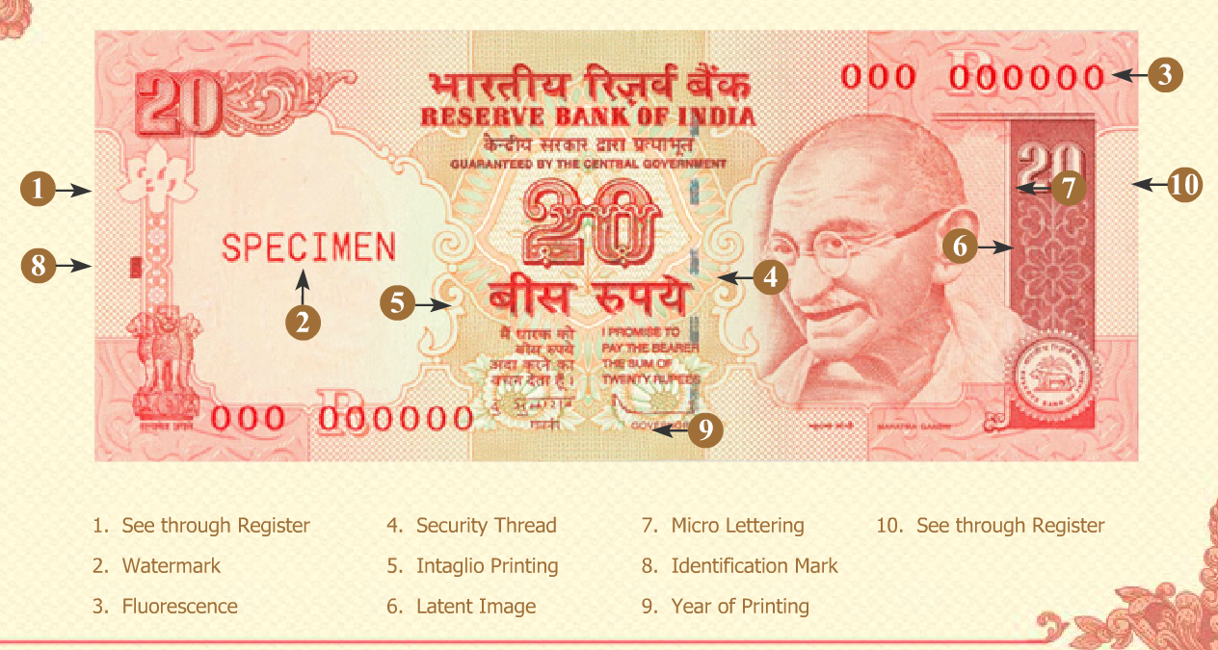

Verticle rectangle

Slide 26
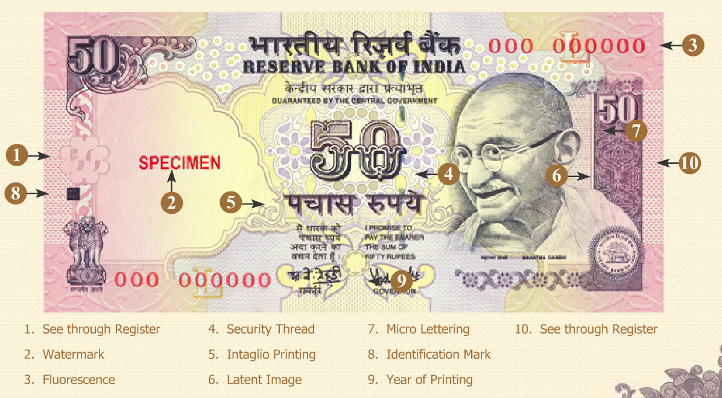


Slide 27
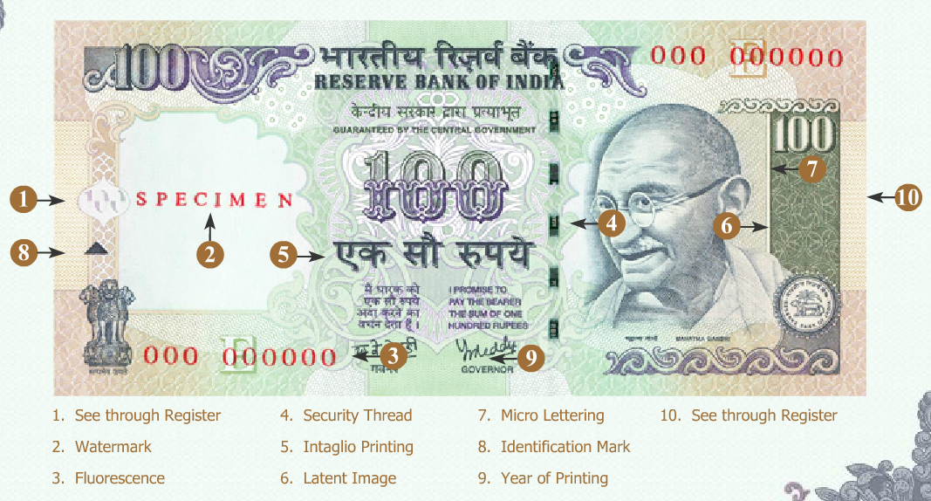


Slide 28

Old notes: Gandhi right side- looking @left
Diamond

Slide 29
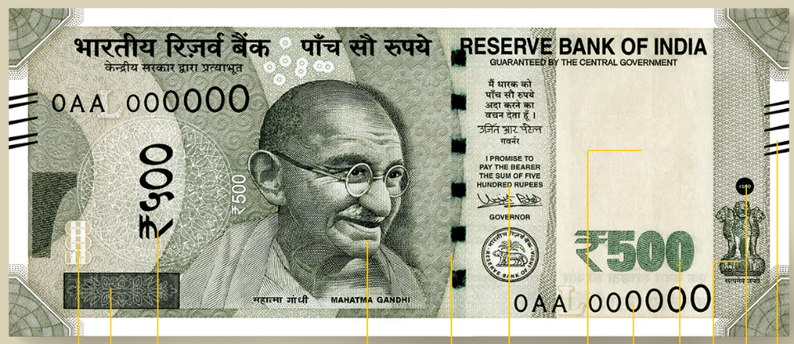
Coin, medal, currency: Front side “obverse” side
VH
VH
watermark
VH
See through register
500
Color shift thread
Not microchip
Sr. no increase font size
Mahatma Gandhi (NEW) series notes.
In 10, 20, 50,100 notes: Gandhi on right side seeing towards left.

Slide 30
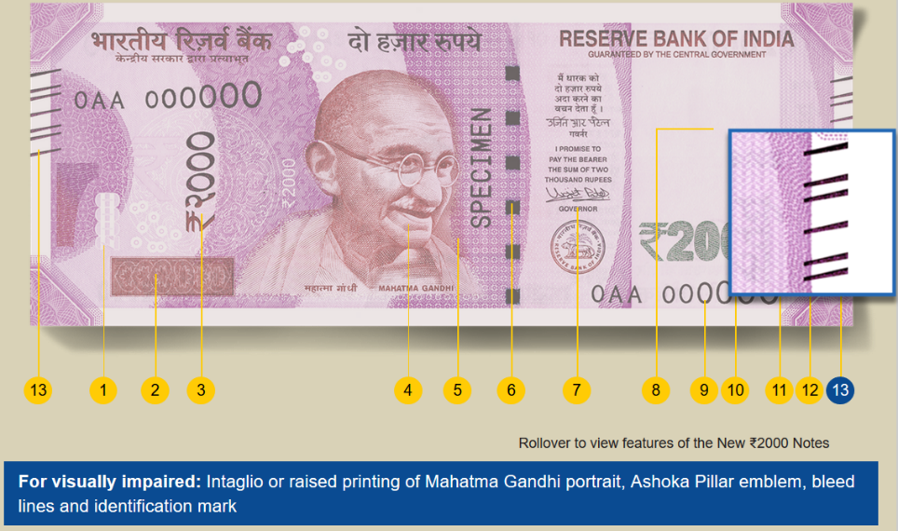
VH: 500 note= 5 lines; 2000 notes= 6 lines.
Hence “reasoning” and aptitude skill asked in competitive exams for officers selection. Else 20 lines would be here. Inconvenient to VH

Slide 31
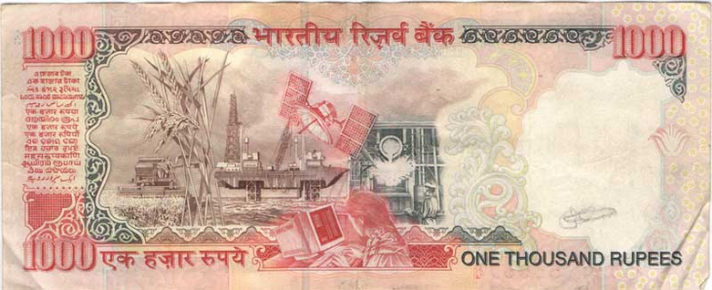
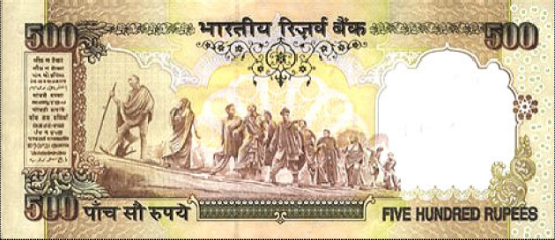
SBN: Banned notes (REVERSE SIDE)
Language panel shifted towards middle

Slide 32
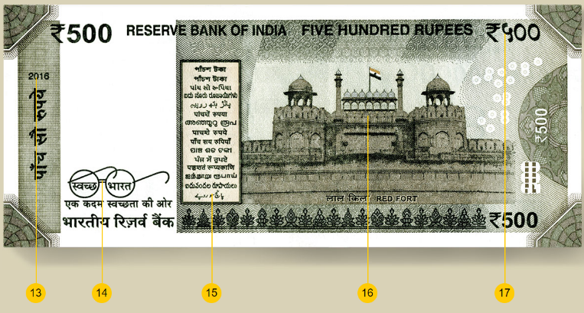
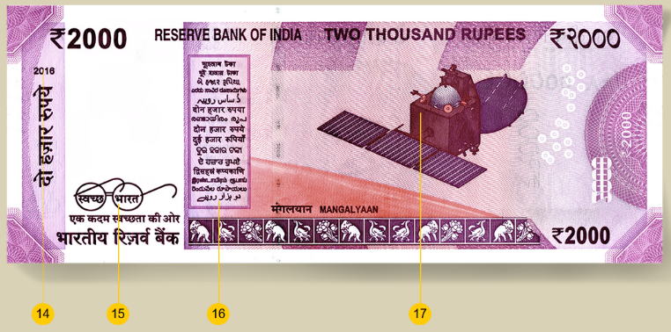
What’s on backside
Reverse?
Red fort
Mangalyan
Fake currency
Scan and printed
ATM “Children's bank of India” – bank’s responsibility.
FICN (and even when done, profit margin ▼)

Slide 33
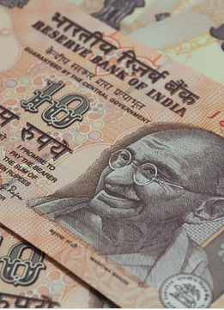
- Counterfeiting - Wear and tear
Plastic Notes
1988: Australia first tried. ~20 nations use it now.
2017, March: RBI to launch polymer based Rs.10 notes.
Trial in 5 cities: Kochi, Mysore, Jaipur, Shimla and Bhubaneswar [geographic and climatic diversity.]

Slide 34
गल्ले पे चर्चा: BTT: Banking transaction Tax
Recent Acts & Schemes
Tax Admin: TDS, TCS….
Demonetization helped or not?
CGT: root of many problems
BEPS, AEoI
PoEM, GAAR [WEF1/4/17], AAR
Electoral-Bonds
Uniqueness
Then is it a failed experiment?
Security Features
Soil Rate?
How did 97% returned?
Short Term challenges Long term Benefits?

Slide 35
Pune-Arthakranti + Baba Ramdev
The concept
Withdraw high value notes (replaced)
Abolish all taxes except import duty
Prohibit cash transaction >2k
Only digital/bank payment.
2% tax on banking transaction (credit, debit)
No tax on depositing or withdrawing money from bank.
BTT | Share
Union | 0.70%
State | 0.60%
Local | 0.35%
Bank | 0.35%
Total | 2%
Why this proposal impractical?
14th FC: union (58: 42) states
BTT: 0.7/2= Union gets 35% (Defense ?)
True that union getting part of what used to be State’s sales tax / VAT. Still quantity wise share will far less..because <next slide>

Slide 36
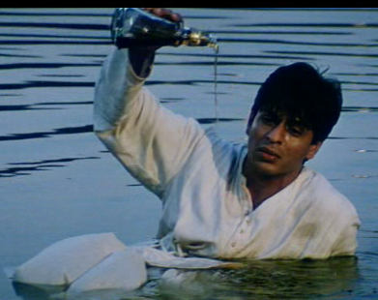
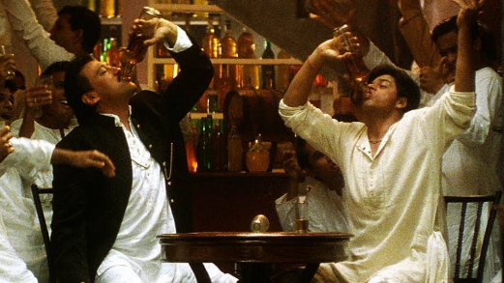
cash transaction upto 2k permitted, without tax ----- bank 2%
Why impractical
Loophole: 500 x 5 = 2500/- ; Inspector raj, bribery
Direct tax: progressive; Indirect : regressive
BTT (2%): Flat => regressive => hurts poor more
Indirect Tax abolished: petrol, diesel, FMCG cheaper but demerit goods also cheaper!?
Indirect tax: Demerit Goods
2k bottle in cash= no BTT!

Slide 37
Why impractical?
BTT
Australia, Argentina, Brazil. Tried and reverted to conventional tax system
7th Schedule- drastic amendment! Even GST was difficult (petrol, diesel, tobacco, deshi and whatever else Devgan touched- had to be kept out!)

Slide 38
5 pronged strategy foreign deshi black money focus more!!
Survey 2017
GST: apply on land and other immovable property
▼ individual income tax rates and real estate stamp duties [Laffer Curve]
▼ corporate tax rate at a fast speed (budget-2016: in next five years: 25%)
Tax administration: reduce harassment, discretion- online systems: less interaction between tax payers and tax officials
Widen income tax net gradually consistent with constitutional arrangements. (= AGRICULTURE!!)
If BTT is impractical, then what is practical?

Slide 39
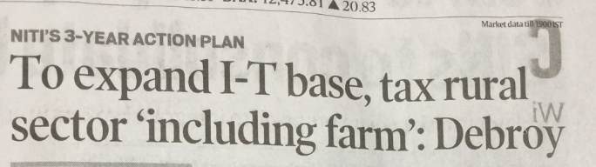
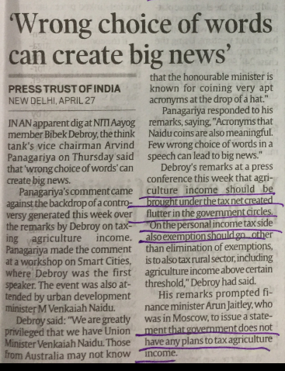
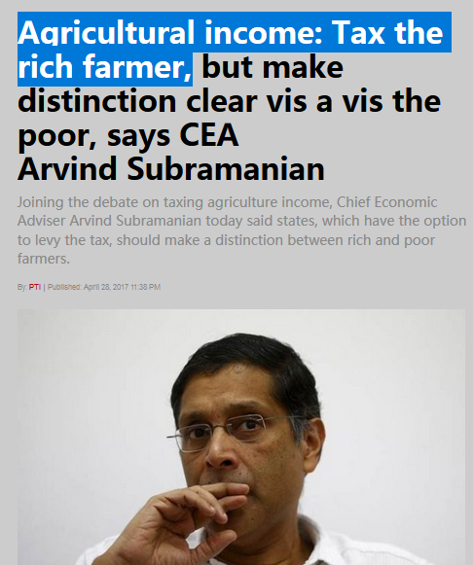
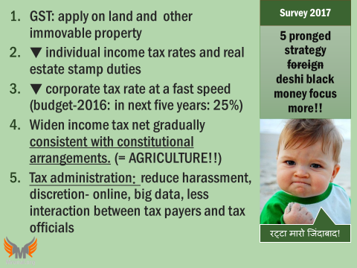
GSM4 Ethics Case Study: how to communicate a policy proposal using “right words”!?

Slide 40
BES172: Budget ► Revenue ► Receipt ► Tax
Goods & Services Tax
Black Money

